Slide 1
Confusion matrix
In
Machine learning

Slide 2
Confusion matrix:
A Confusion matrix is used for evaluating the performance of
a classification model, where N is the number of target classes.
The matrix compares the actual target values with those
predicted by the machine learning model.
and it shows us how well our classification model is
performing and what kinds of errors it is making.

Slide 3
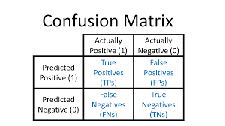

Slide 4
True Positive: Actual Positive and Predicted as Positive
True Negative: Actual Negative and Predicted as Negative
False Positive(Type I Error): Actual Negative but predicted as
Positive
False Negative(Type II Error): Actual Positive but predicted as
Negative

Slide 5


Precision and recall:
Precision: precision will calculate by total true / positive values
from predicted yes values.
Recall: recall will calculate by total true / sum of true positive
and false negative.

Slide 6
ACCURACY:
Accuracy: It is simply a ratio of correctly predicted observation
to the total observations.
And it will show how our model is performing good or bad .
And the value of the good model should be very high.
formula: accuracy= TP+TN/TP+FP+FN+TN

Slide 7
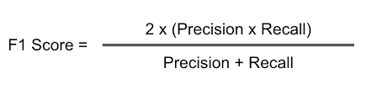
F1 SCORE:
It is difficult to compare two models with low precision and high
recall or vice versa. So to make them comparable, we use F-Score.
F-score helps to measure Recall and Precision at the same time.
It uses Harmonic Mean in place of Arithmetic Mean by punishing
the extreme values more.

Slide 8
Thank you

